Slide 1
02
03
04
05
01
06
07
08
09
10
11
T20 CRICKET 2022
Data Analytics

Slide 2
01
02
03
04
05
06
07
08
09
10
11
T20 CRICKET 2022
Data Analytics

Slide 3
01
02
03
04
05
06
07
08
09
10
11
Understanding Business Problem

Slide 4
01
02
03
04
05
06
07
08
09
10
11
Requirement Scoping & Web Scraping

Slide 5
01
02
03
04
05
06
07
08
09
10
11
Data Cleaning & Transformation

Slide 6
01
02
03
04
05
06
07
08
09
10
11
Data Modelling

Slide 7
01
05
02
03
04
06
07
08
09
10
11
Mock-up Dashboard

Slide 8
01
05
06
02
03
04
07
08
09
10
11
Power Hitters

Slide 9
01
05
06
02
03
04
07
08
09
10
11
Anchors

Slide 10
01
05
06
02
03
04
07
08
09
10
11
Finishers

Slide 11
01
05
06
02
03
04
07
08
09
10
11
All Rounders

Slide 12
01
05
06
02
03
04
07
08
09
10
11
Fast Bowlers

Slide 13
01
05
06
11
02
03
04
07
08
09
10
Final 11

Slide 14

1
Understanding Business Problem
Planet Earth
Vs
Planet Sportan
📊Problem Statement :
Scenario:
Earth is under threat from an impending alien invasion.
The aliens propose a high-stakes T20 cricket match to decide the fate of humanity.
The challenge: Assemble the “DREAM 11" cricket team from Earth's cricketing talents to compete against the Aliens 11.
Objective:
To save humanity, we need to form the strongest possible cricket team.
The team should be able to score at least 180 runs on an average and should be able to defend 150 runs on an average.
The team should consist of the best players across various roles (batsmen, bowlers, all-rounders, wicketkeepers).
1

Slide 15
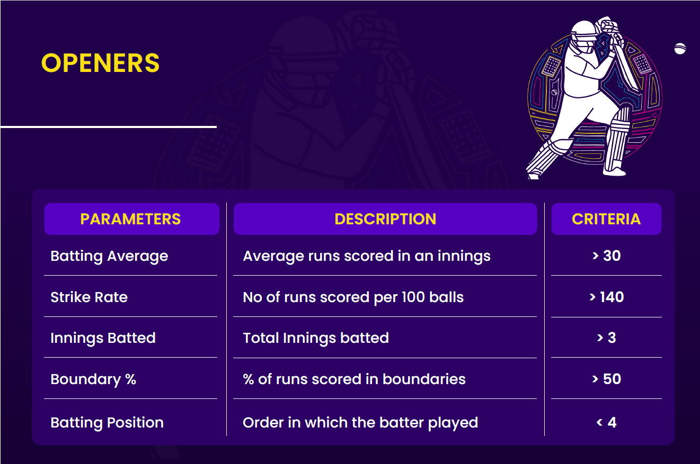
2
Requirement Scoping & Web Scraping
OPENERS - Selection Criteria
2

Slide 16
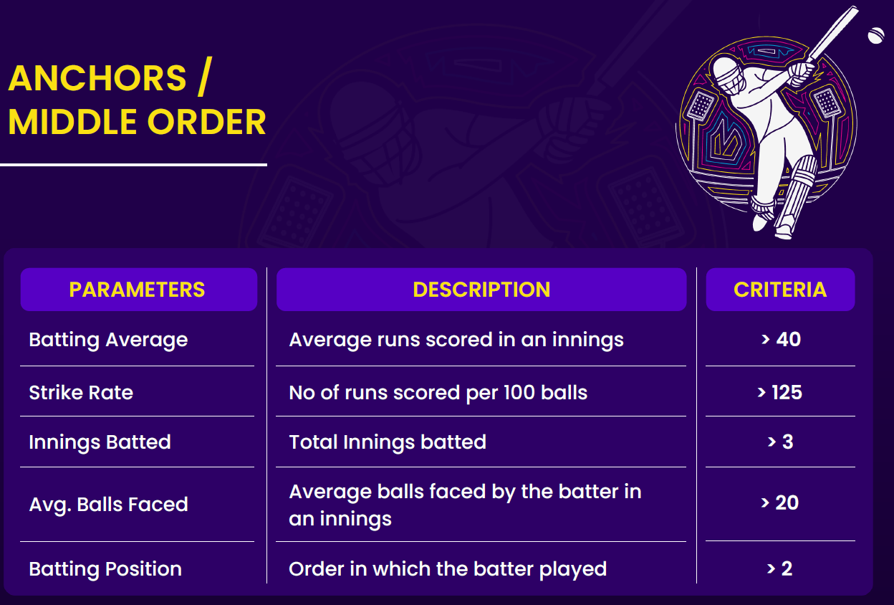
2
Requirement Scoping & Web Scraping
ANCHORS/ MIDDLE ORDER - Selection Criteria
2

Slide 17
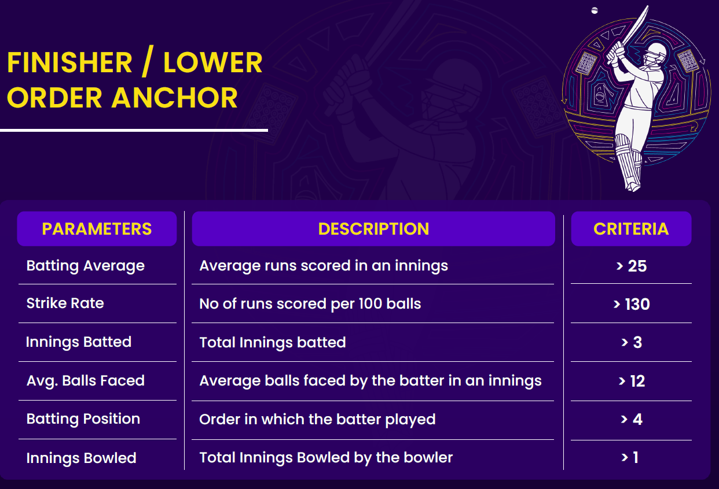
2
Requirement Scoping & Web Scraping
FINISHER/ LOWER ORDER - Selection Criteria
2

Slide 18
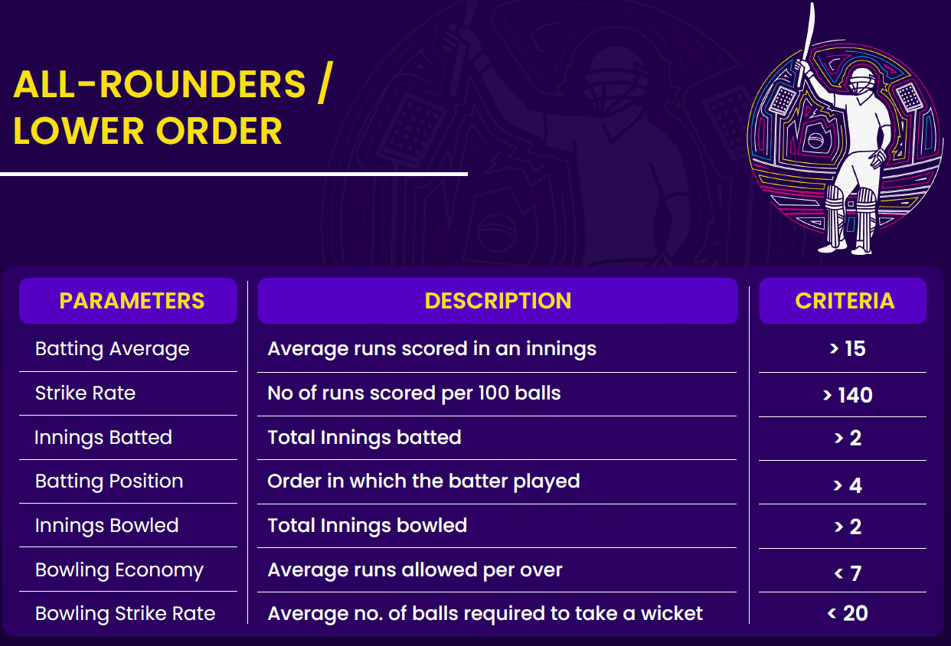
2
Requirement Scoping & Web Scraping
ALL-ROUNDERS - Selection Criteria
2

Slide 19
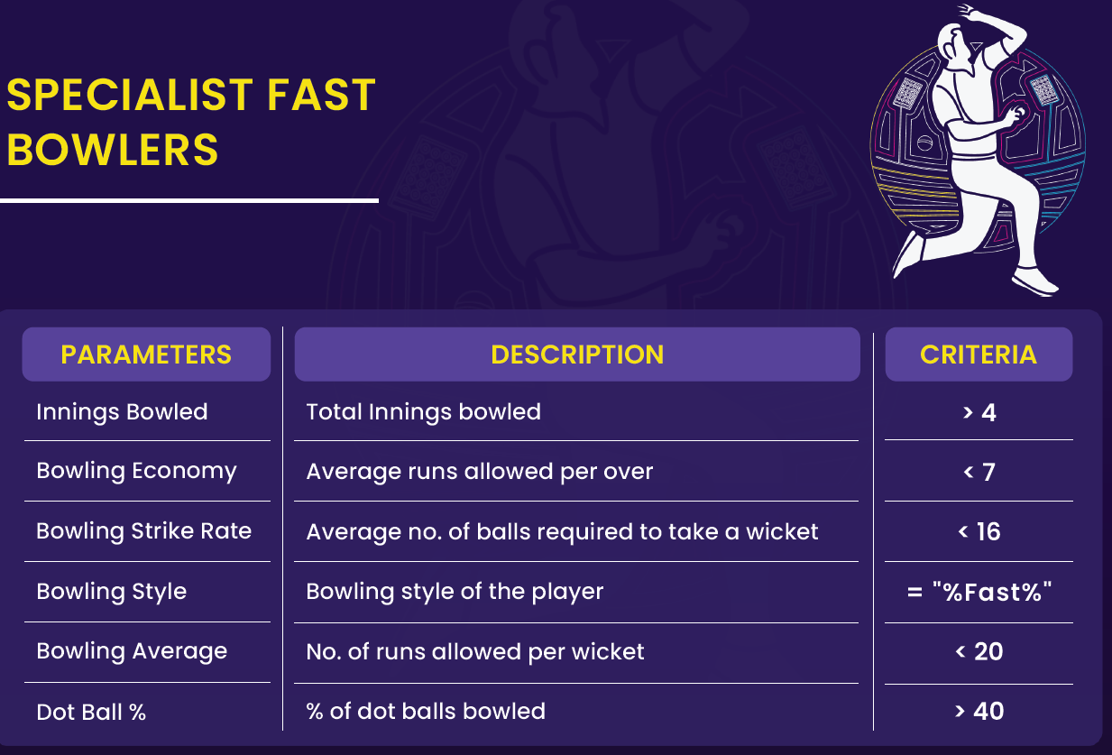
2
Requirement Scoping & Web Scraping
FAST BOWLERS - Selection Criteria
2

Slide 20







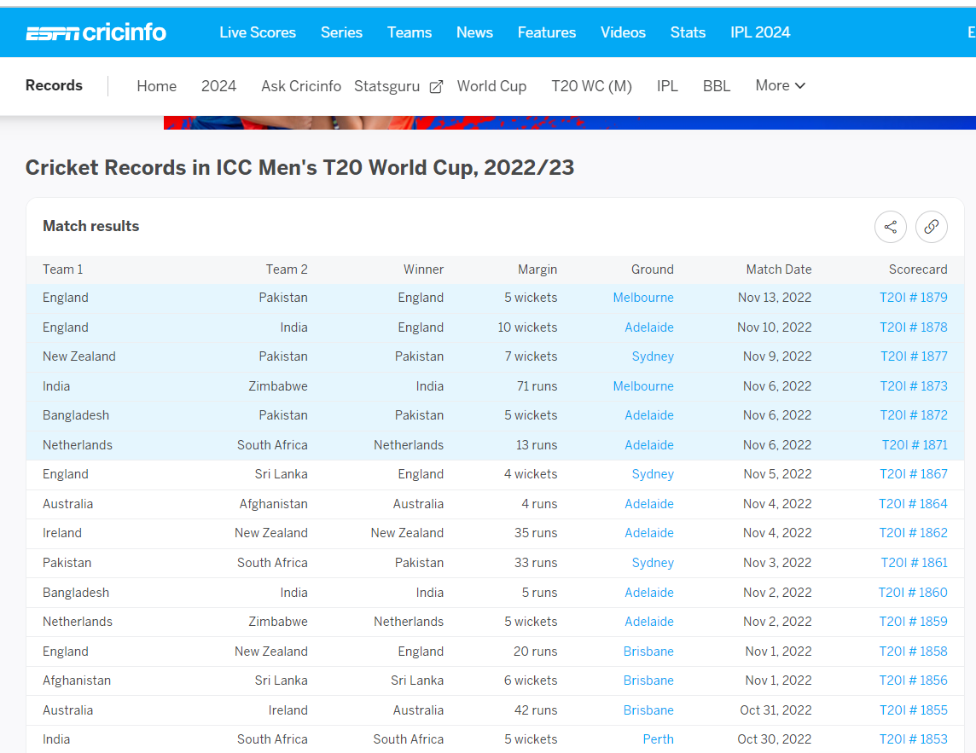
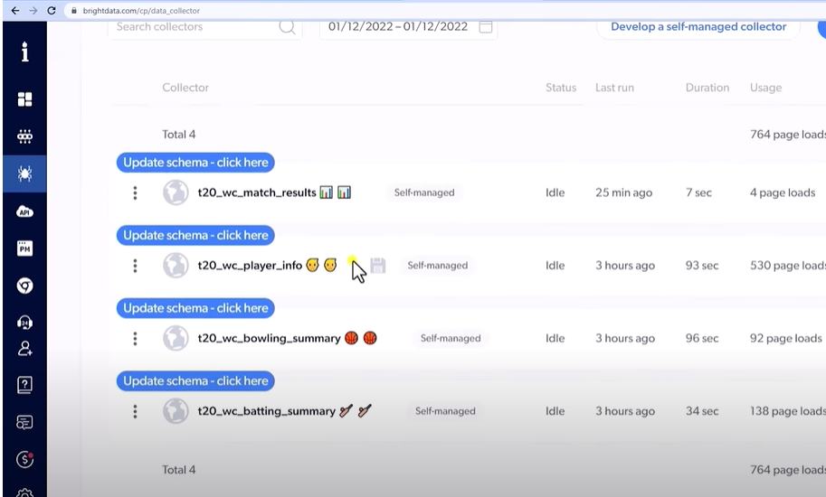
2
Requirement Scoping & Web Scraping
ESPN Data
Bright Data Web Scraping
2

Slide 21
2
Requirement Scoping & Web Scraping
ESPN Data
Bright Data Web Scraping
2

Slide 22
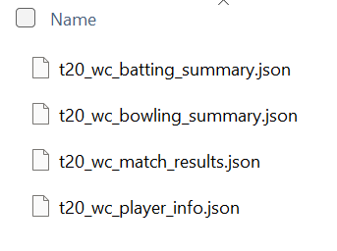
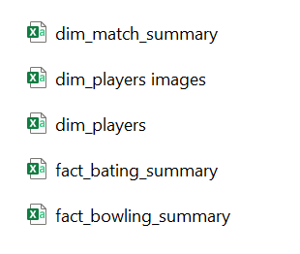
2
Requirement Scoping & Web Scraping
Bright Data Web Scraping
Json Files
CSV Files
ESPN Data
2

Slide 23
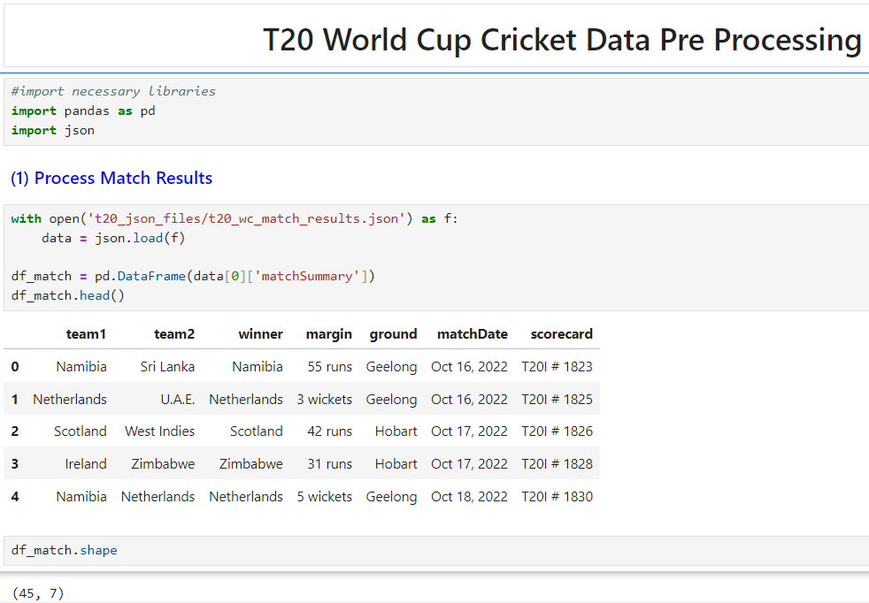
3
Data Cleaning & Transformation
Match Summary CSV file creation
As part of converting a Json file to CSV, scorecard column in the df_match data frame will be renamed to match_id.
3

Slide 24
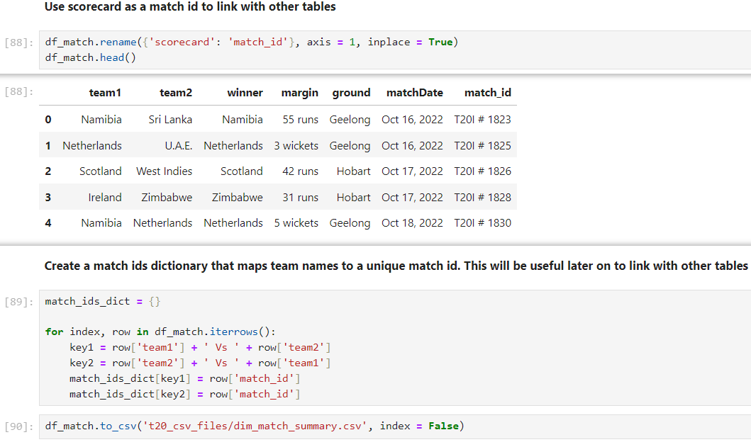
3
Data Cleaning & Transformation
Match Summary CSV file creation
As part of converting a Json file to CSV, “scorecard” column in the df_match data frame is renamed to “match_id”.
Match ids dictionary is created, so that it will be used to link with other tables.
“dim_match_summary” CSV file is created
3

Slide 25
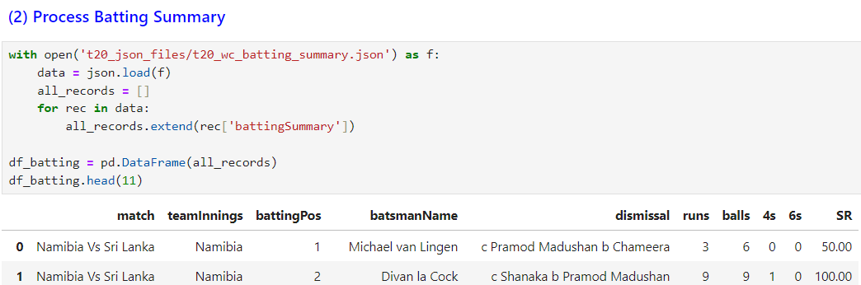
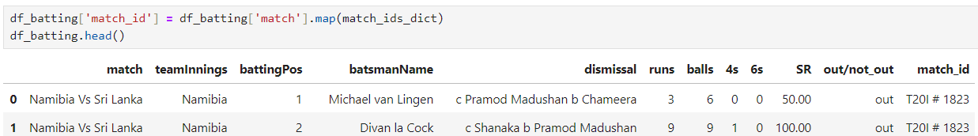
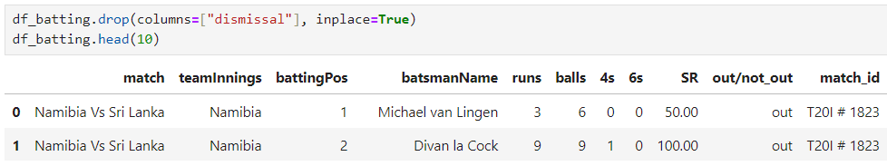
3
Data Cleaning & Transformation
Batting Summary CSV file creation
In df_batting data frame “dismissal” column should be removed by replacing with a “out/not out "column.
“out/not out "column is created.
“dismissal” column is dropped
3

Slide 26
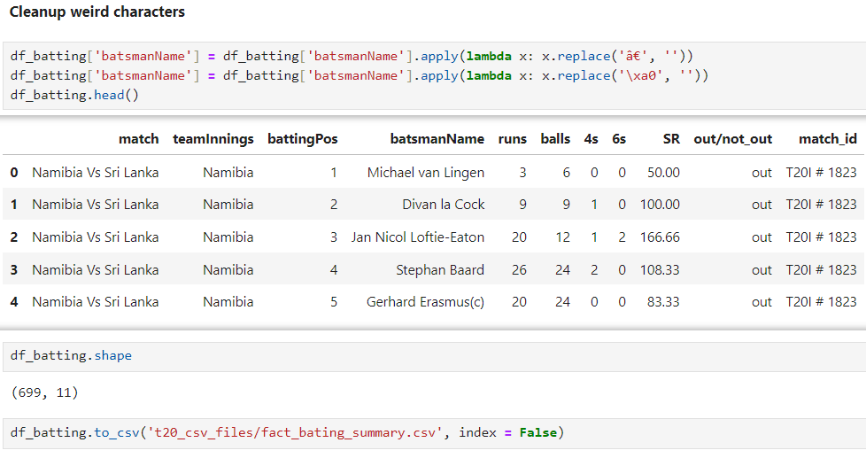
3
Data Cleaning & Transformation
Batting Summary CSV file creation
Cleaning up weird characters by using a lambda function.
“fact_batting_summary” CSV file is created
3

Slide 27
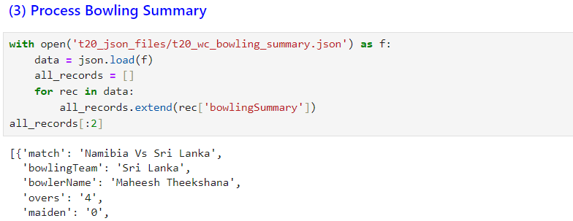
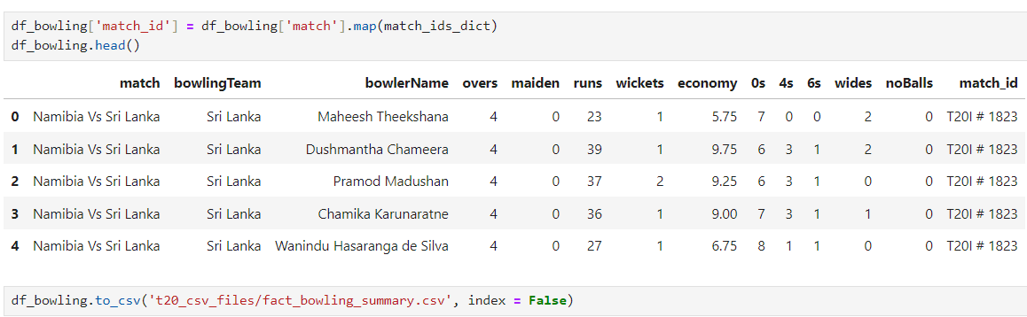
3
Data Cleaning & Transformation
Bowling Summary CSV file creation
Loading bowling summary Json file.
“match_id” column is added to the df_bowling dataframe.
“fact_bowling_summary” CSV file is created
3

Slide 28
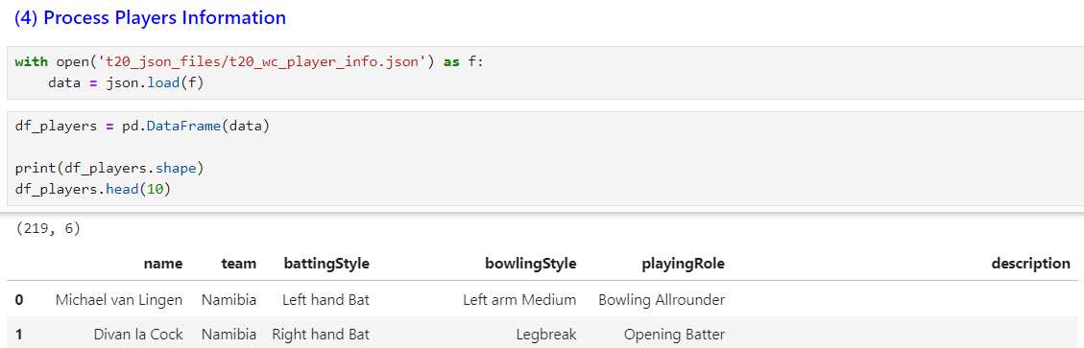
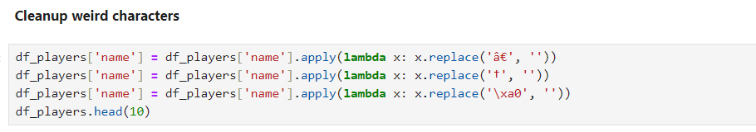
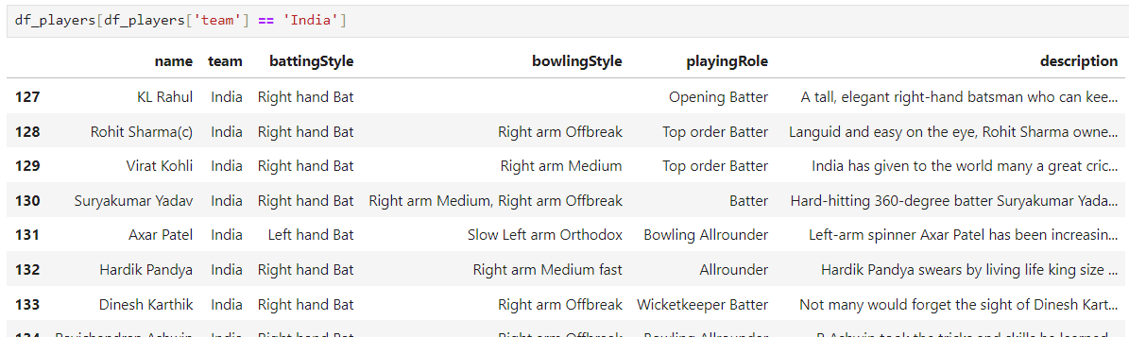
3
Data Cleaning & Transformation
Players Summary CSV file creation
Loading players summary Json file.
Cleaning up weird characters by using a lambda function.
“dim_players_images” CSV file is created
3

Slide 29
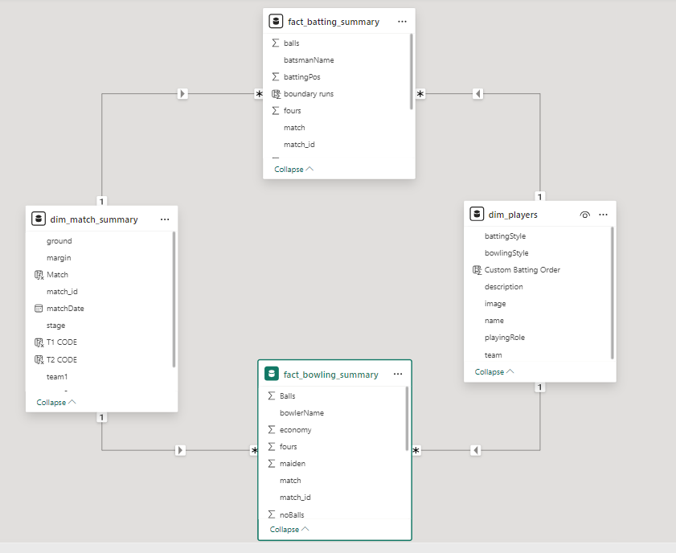
4
Data Modelling
Star Schema Data Modelling
4

Slide 30
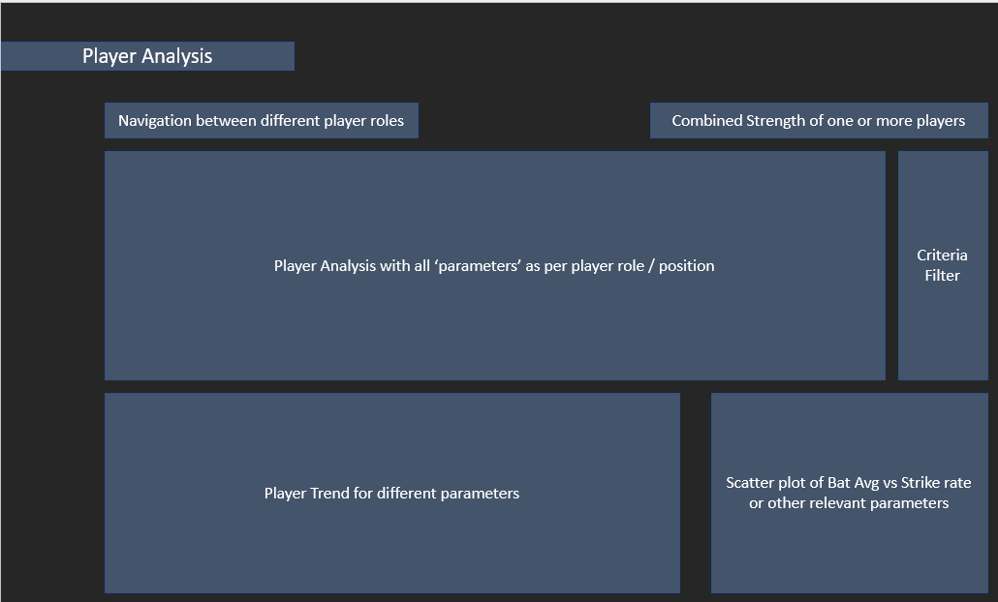
5
Mock-up Dashboard
5

Slide 31
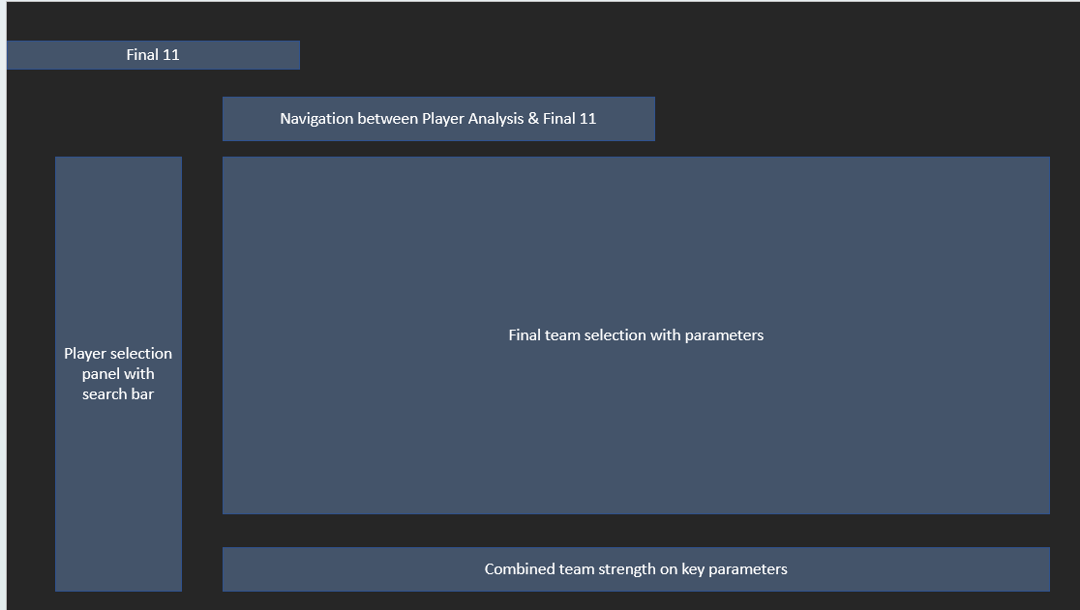
5
Mock-up Dashboard
5

Slide 32

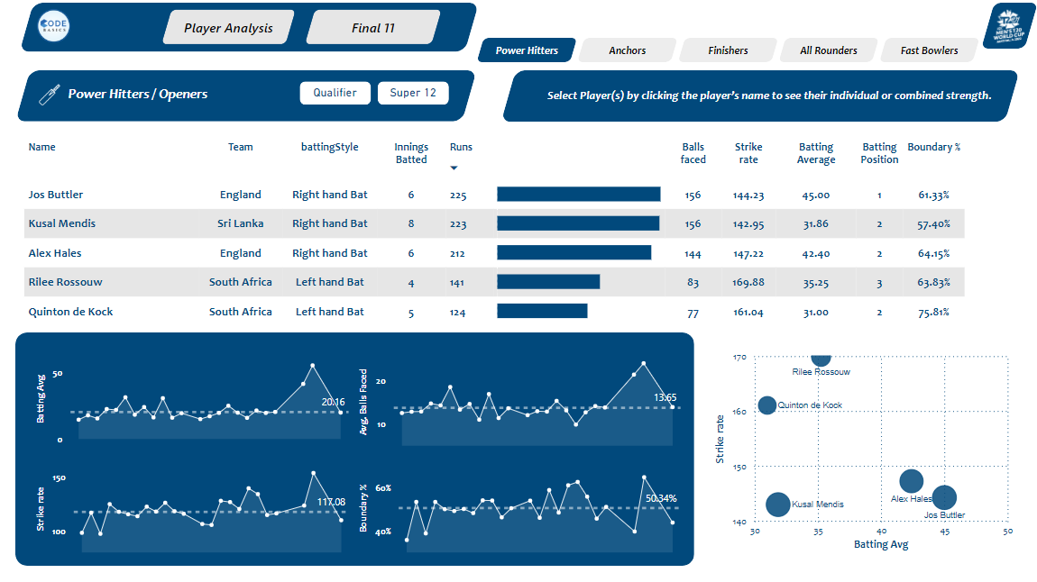
Power BI – Power Hitters Page
“Power Hitters / Openers Selection criteria and Insights” are mentioned below.
Batting Average should be >30
Strike Rate should be >140
Boundary % >50
Jos Butler can be selected, because consistently he has performed very well with strike rate >140 and Boundary % is 61.33%. & moreover, he is also a Wicket Keeper
In cricket, Left Hand Opener is very much important, so another player who can be selected is Rilee Rossouw.
Rilee Rossouw’s Strike rate is 169.88 and Boundary % is 63.83% which is tremendous.
Combined performance of both if you see
Batting Average is 40.67
Strike Rate is 153.14
Balls faced is 23.90
Boundary % is 62.30% , so most of the runs are coming from boundaries only.
6
6

Slide 33
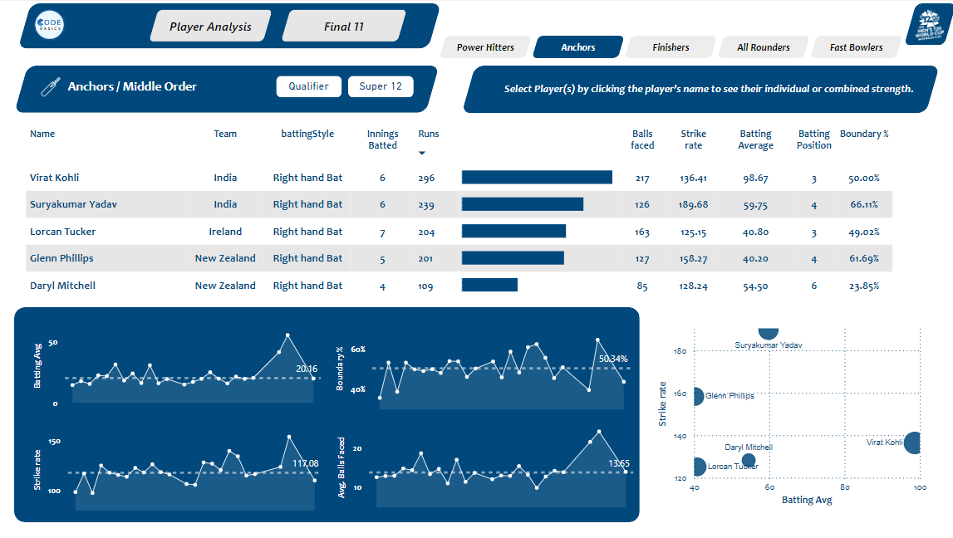
Power BI – Anchors Page
“Anchors/ Middle Orders Selection criteria and Insights” are mentioned below.
Batting Average should be >40
Strike Rate should be >125
Average balls faced > 20
Virat Kohli is the clear winner here and he is a run machine he should be at No 3 with strike rate of 136.41 and Batting Avg is 98.67
No 4 Player is Surya Kumar Yadav with strike rate of whooping 189.68 and Batting Avg is 59.75
No 5 Player can be Glen Phillips with strike rate of 158.27 and Batting Avg is 40.20
7
7

Slide 34
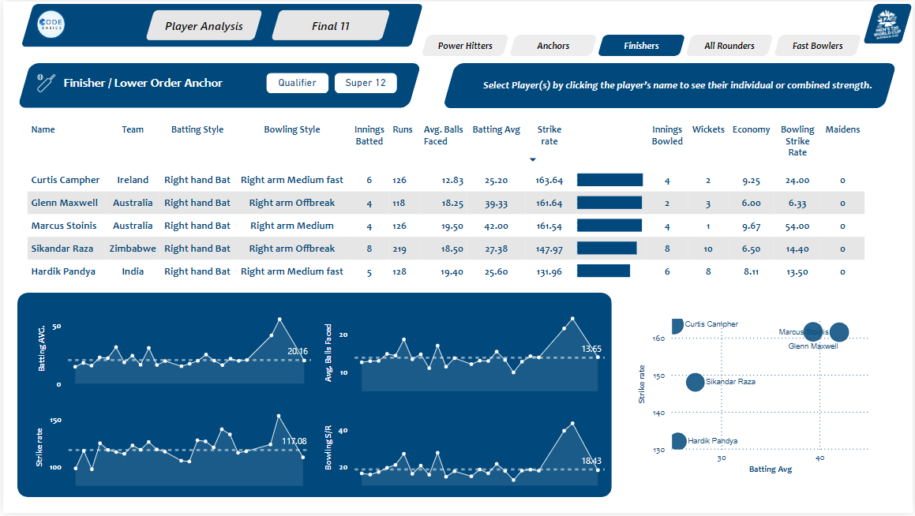
Power BI – Finishers Page
“Finishers / Lower Orders Selection criteria and Insights” are mentioned below.
Batting Average should be >25
Strike Rate should be >130
Average balls faced > 12
Glen Maxwell can be selected at No 6 with strike rate of 161.64 and Batting Avg of 39.33 would be the right choice.
Another 2 options would be Marcus Stoinis & Hardik Pandya based on pitch conditions.
8
8

Slide 35
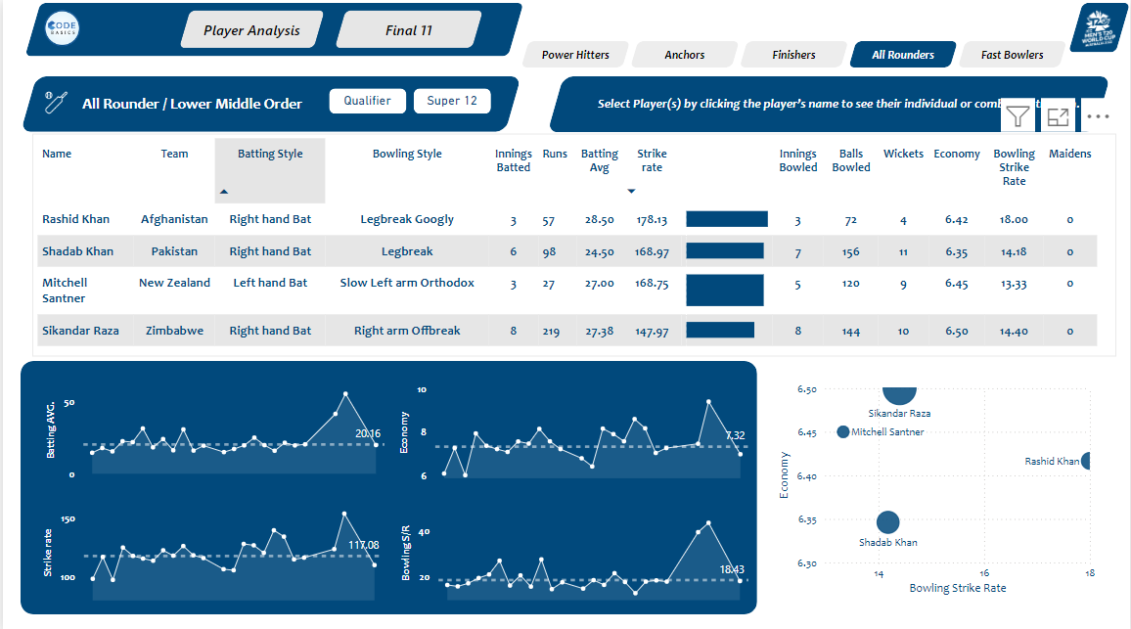
Power BI – All Rounders Page
“All Rounders Selection criteria and Insights” are mentioned below.
Batting Average should be >15
Strike Rate should be >140
Bowling Economy <7
Bowling Strike Rate <20
Mitchell Santner can be selected at No 7 with Batting strike rate of 168.75, Batting Avg of 27.00 & Bowling Strike Rate of 13.33 would be the right choice.
Sikandar Raza can be selected at No 8 with strike rate of 147.97, Batting Avg of 27.38 & Bowling Strike Rate of 14.40
9
9

Slide 36
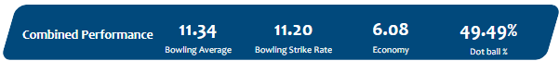
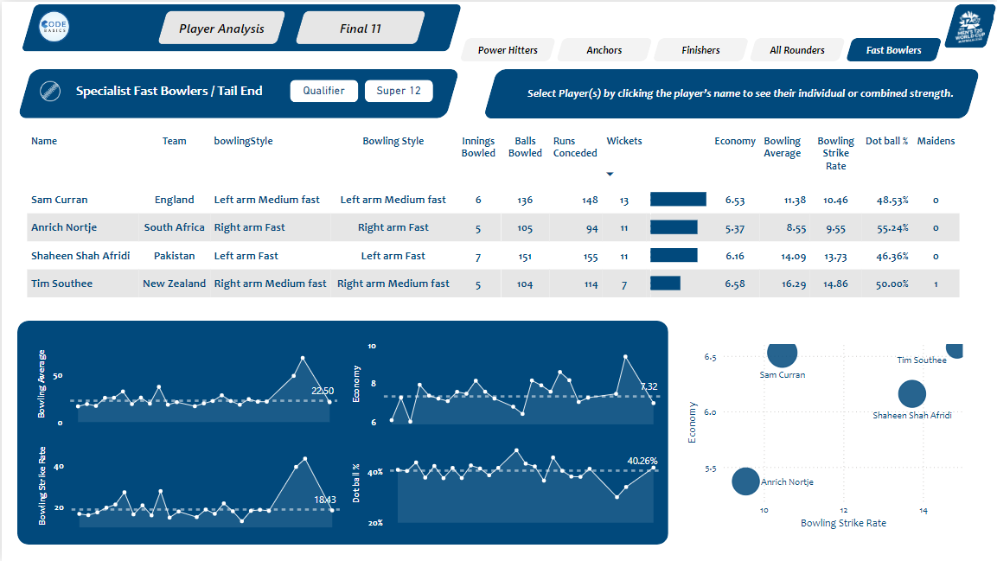
Power BI – Fast Bowlers Page
“Fast Bowlers Selection criteria and Insights” are mentioned below.
Bowling Economy <7
Bowling Strike Rate <16
Bowling Average < 20
Dot Ball % > 40
Sam Curran can be selected at No 9, because Economy is 6.53, Bowling Strike Rate is 10.46 & Dot Ball % is 48.53%
Anrich Nortje & Shaheen Shah Afridi can be selected at No 10 & No 11 respectively based on their performances.
Combined performance of all 3 if you see
Bowling Average is 11.34
Bowling Strike Rate is 11.20
Economy is 6.08 is pretty good in T20 matches
Dot ball% is around 49.49 % is excellent.
10
10

Slide 37
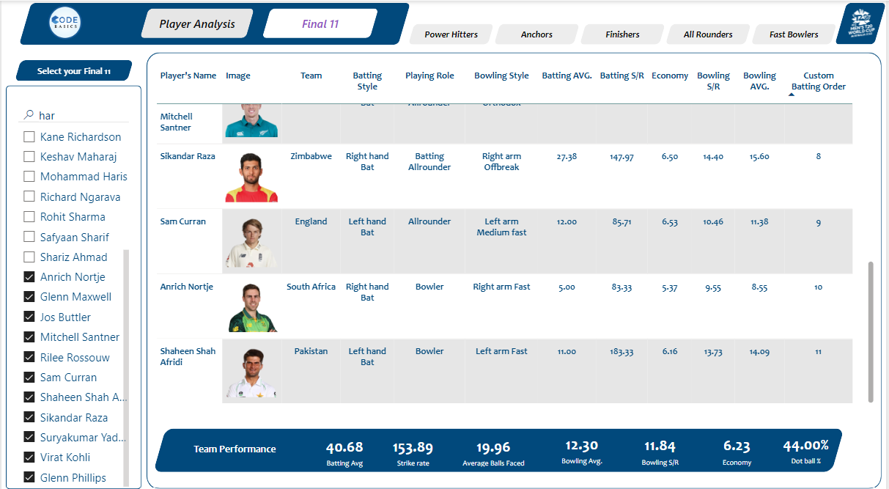
Power BI – Final 11
“Final 11 Selection criteria and Insights” are mentioned below.
Combined Team performance of Final 11 are mentioned below.
Batting Average is 40.68
Batting Strike Rate is 153.89
Balls faced is 19.96
Bowling Average is 12.30
Bowling Strike rate is 11.84
Economy is 6.23 is pretty good in T20 matches
Dot ball% is around 44 %, it is excellent.
11
11

Slide 38




Power BI – Final 11
11
PROJECT SPORTAN
BEST T20 XI TO SAVE OUR PLANET
JOS BUTTLER
MITCHELL SANTNER
RILEE ROSSOUW
SIKANDAR RAZA
VIRAT KOHLI
SAM CURRAN
SURYAKUMAR YADAV
ANRICH NORTJE
GLENN PHILLIPS
SHAEEN SHAH AFRIDI
GLENN MAXWELL
11

Slide 39




T20 CRICKET 2022
Data Analytics
THANK YOU
1
Mr. DHAVAL PATEL
Mr. HEMANAND VADIVEL

Slide 40
02
03
04
05
01
06
07
08
09
10
11
T20 CRICKET 2022
Data Analytics

